Slide 1
Object Oriented Programming—C++ Lecture 11 Final Review
Qijun Zhao
College of Computer Science
Sichuan University
Spring 2025

Slide 2
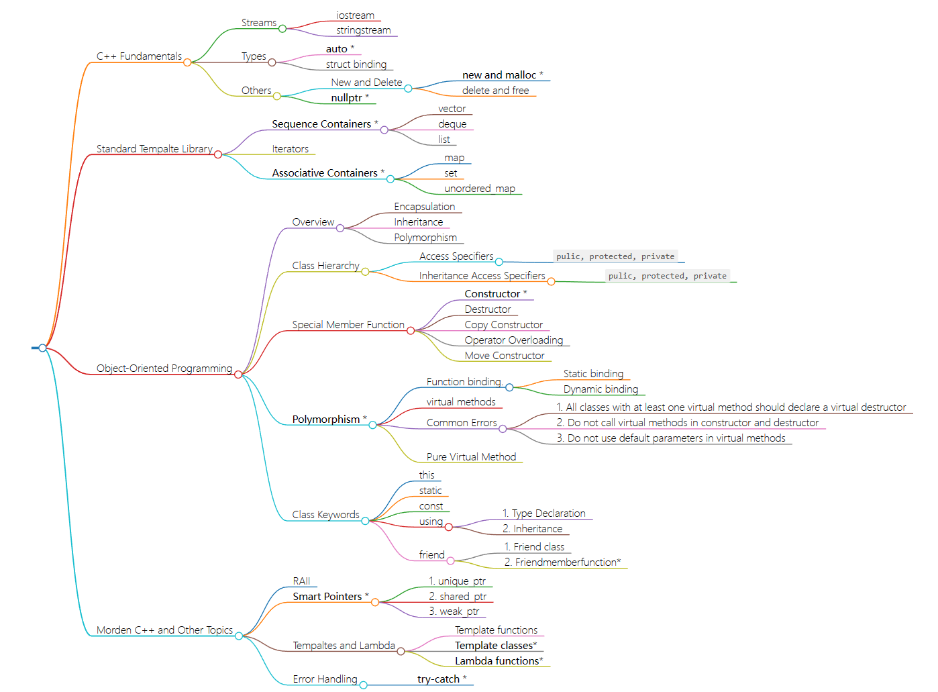

Slide 3
1. C++ Fundamentals and STL
1.1 Stream
1.2 Types
1.3 STL
1.4 Memory Manage

Slide 4
1.1 Streams
Streams are an abstraction for input/output. Streams convert between data and the string representation of data.
std::cin / std::cout : console input / output with type std::istream / std::ostream.
std::cerr : standard error stream.
std::ifstream / std::ofstream : type of file stream.
std::stringstream : type of string stream
Streams have overloaded operators << and >>.
std::getline() is a function to get a line or read until meet the delimiter.

Slide 5
1.2 Types: auto Keyword
C++11 The auto keyword specifies that the type of the variable will be automatically deduced by the compiler (from its initializer)
auto
does not mean that the variable doesn’t have a type. It means that the type is deduced by the compiler.

Slide 6
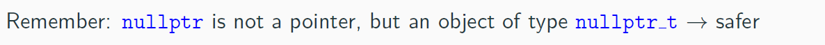
1.2 Types: nullptr Keyword
C++11 introduces the new keyword
nullptr
to represent a null pointer ( 0x0 ) and
replacing the macro. In C++, we can’t convert a void* pointer to any other pointer implicitly, but we can do it in C. So nullptr is needed.
NULL

Slide 7
1.2 Types: Reference
A variable reference T& is an alias, namely another name for an already existing variable. Both variable and variable reference can be applied to refer the value of the variable.
A pointer has its own memory address and size on the stack, reference shares the same memory address (with the original variable).
The compiler can internally implement references as pointers, but treats them in a very different way.
Features:
References cannot have NULL value. You must always be able to assume that a reference is connected to a legitimate storage
References cannot be changed. Once a reference is initialized to an object, it cannot be changed to refer to another object
References must be initialized when they are created.

Slide 8
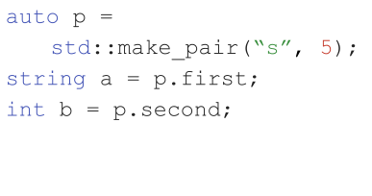
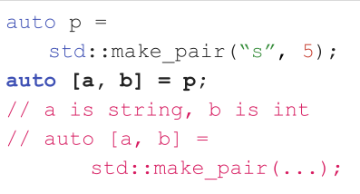
Structured Binding
Structured binding lets you initialize directly from the contents of a struct
Before
After
📝 This works for regular structs, too. No nested structured binding.

Slide 9
1.3 STL Containers
C++ STL are data structures storing objects of the same data type in a linear mean manner.
The STL Sequence Containers are:
● std::array provides a fixed-size contiguous array (on stack)
● std::vector provides a dynamic contiguous array
● std::list provides a double-linked list
● std::duque provides a double-ended queue
● std::forward_list provides a single-linked list
While std::string is not included in most container lists, it actually meets the requirements of a Sequence Container

Slide 10
STL containers:
An associative container is a collection of elements not necessarily indexed with sequential integers and that supports efficient retrieval of the stored elements through keys
Keys are unique:
● std::set is a collection of sorted unique elements (operator<)
● std::unordered_set is a collection of unsorted unique keys
● std::map is a collection of unique pairs, sorted by keys
● std::unordered map is a collection of unique pairs, unsorted
Multiple entries for the same key are permitted
● std::multiset is a collection of sorted elements (operator<)
● std::unordered_multiset is a collection of unsorted elements
● std::multimap is a collection of pairs, sorted by keys

Slide 11
STL container iterators
All containers implement iterators, but they’re not all the same!
Each container has its own iterator, which can have different behavior.
All iterators implement a few shared operations:
Initializing: iter = s.begin();
Incrementing: ++iter;
Dereferencing: *iter;
Comparing: iter != s.end();
Copying: new_iter = iter;

Slide 12
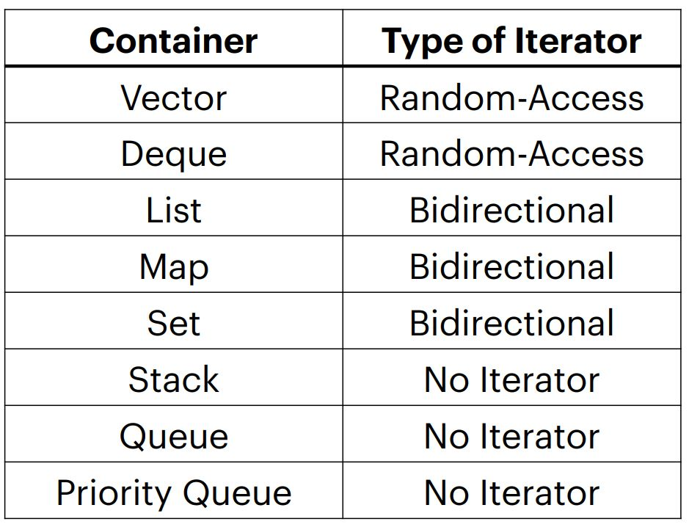
Categorizing STL iterators
Vectors and deques have the most powerful iterators!
Creating your own containers means creating their iterators as well.
You can access elements in stacks and queues one-by-one, but you have to change the container to do so!
Iteration with iterators is const

Slide 13
1.4 Memory manage
new, delete
new/new[] and delete/delete[] are C++ keywords that perform dynamic
memory allocation/deallocation, and object construction/destruction at runtime
malloc
and
free
are C functions and they only allocate and free memory blocks
(expressed in bytes)

Slide 14
1.4 Memory manage
Smart pointers
Smart pointer is a pointer-like type with some additional functionality, e.g. automatic memory deallocation (when the pointer is no longer in use, the memory it points to is deallocated), reference counting, etc.
C++11 provides three smart pointer types:
• std::unique_ptr
• std::shared_ptr
• std::weak_ptr
Smart pointers prevent most situations of memory leaks by making the memory deallocation automatic.

Slide 15
2.OOP
2.1 RAII
2.2 Class Hierarchy
2.2.1 Access Specifiers
2.2.2 Inheritance Access Specifiers
2.3 Class Special Member Function
2.4 Polymorphism
2.5 Class Keywords
2.6 Templates

Slide 16
2.1 RAII
RAII Idiom - Resource Acquisition is Initialization
Holding a resource is a class invariant, and is tied to object lifetime
RAII Idiom consists in three steps:
• Encapsulate a resource into a class (constructor)
• Use the resource via a local instance of the class
• The resource is automatically releases when the object gets out of scope
(destructor)
Implication 1: C++ programming language does not require the garbage collector!!
Implication 2: The programmer has the responsibility to manage the resources.

Slide 17
2.2 Class Hierarchy
Child/Derived Class or Subclass
A new class that inheriting variables and functions from another class is called a derived or child class
Parent/Base Class
The closest class providing variables and functions of a derived class is called parent or base class
Extending a base class refers to creating a new class which retains characteristics of the base class and on top it can add (and never remove) its own members

Slide 18
2.2.1 Access specifiers
The access specifiers define the visibility of inherited members of the subsequent base
class. The keywords public , private , and protected specify the sections of visibility
The goal of the access specifiers is to prevent a direct access to the internal representation of the class for avoiding wrong usage and potential inconsistency (access control)
• public: No restriction (function members, derived classes, outside the class)
• protected: Function members and derived classes access
• private: Function members only access (internal)
struct has default public members
class has default private members

Slide 19
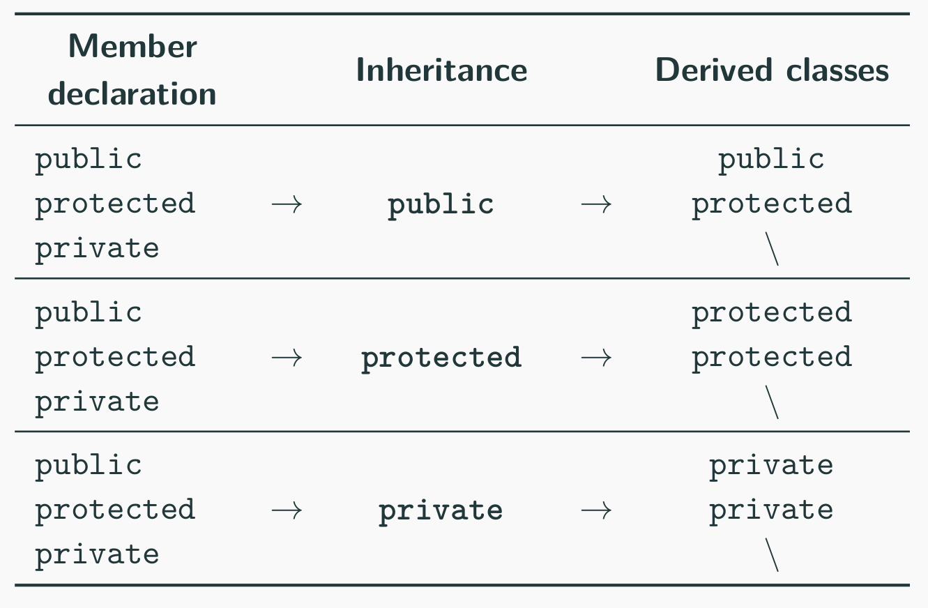
2.2.2 Inheritance Access Specifiers
The access specifiers are also used for defining how the visibility is propagated from the base class to a specific derived class in the inheritance

Slide 20
2.3 Class Special Member Function
Class Constructor and Destructor
Constructor [ctor]
A constructor is a special member function of a class that is executed when a new instance of that class is created Goals: initialization and resource acquisition Syntax: T(...) same named of the class and no return type
• A constructor is supposed to initialize all data members
• We can define multiple constructors with different signatures
• Any constructor can be constexpr

Slide 21
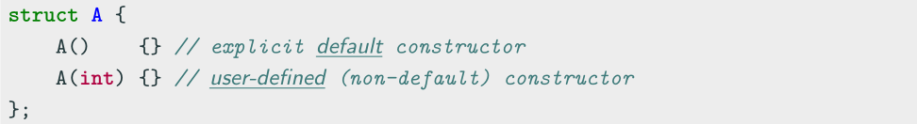
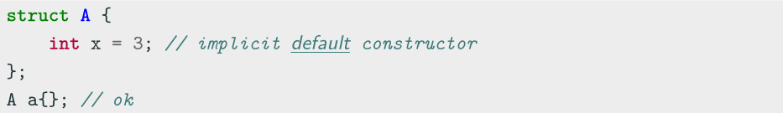
Default Constructor
Default Constructor
The default constructor T() is a constructor with no argument
Every class has always either an implicit or explicit default constructor
• An implicit default constructor is constexpr

Slide 22
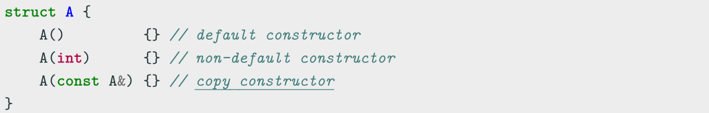
Copy Constructor
Copy Constructor
A copy constructor T(const T&) creates a new object as a deep copy of an existing object
Every class always defines an implicit or explicit copy constructor
Even the copy constructor implicitly calls the default Base class constructor
Even the copy constructor is considered a non-default constructor

Slide 23
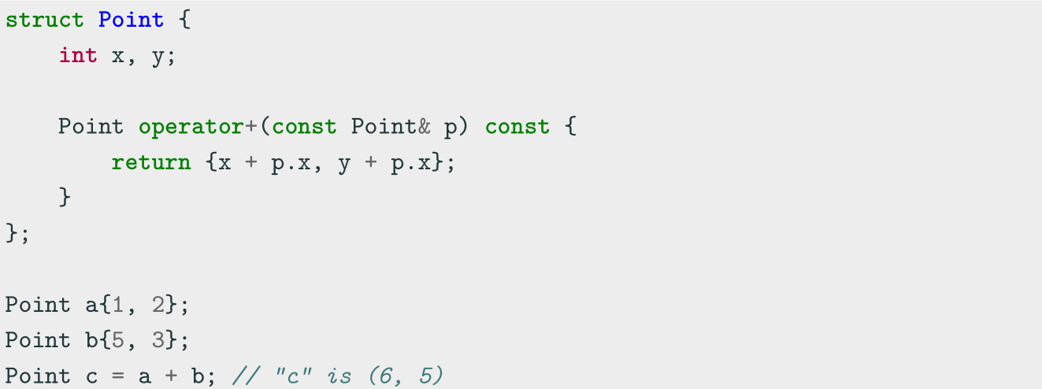
Operator Overloading
Operator Overloading
Operator overloading is a special case of polymorphism in which some operators are treated as polymorphic functions and have different behaviors depending on the type of its arguments

Slide 24
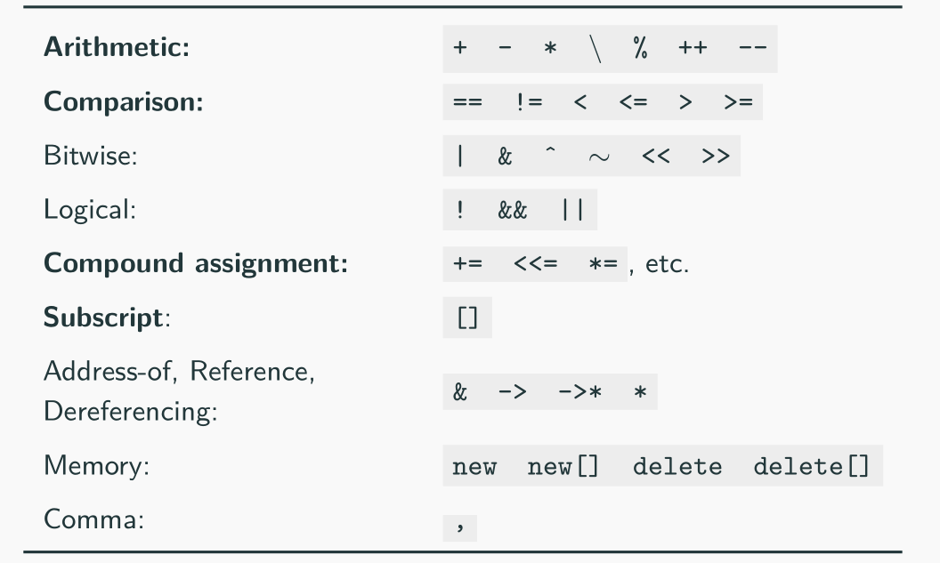
Operator Overloading
Categories not in bold are rarely used in practice
Operators which cannot be overloaded: ? . .* :: sizeof typeof

Slide 25
2.4 Polymorphism
Polymorphism
In Object-Oriented Programming (OOP), polymorphism (meaning “having multipleforms”) is the capability of an object of mutating its behavior in accordance with the specific usage context
• At run-time, objects of a base class behaves as objects of a derived class
• A Base class may define and implement polymorphic methods, and derived classes can override them, which means they provide their own implementations, invoked at run-time depending on the context

Slide 26
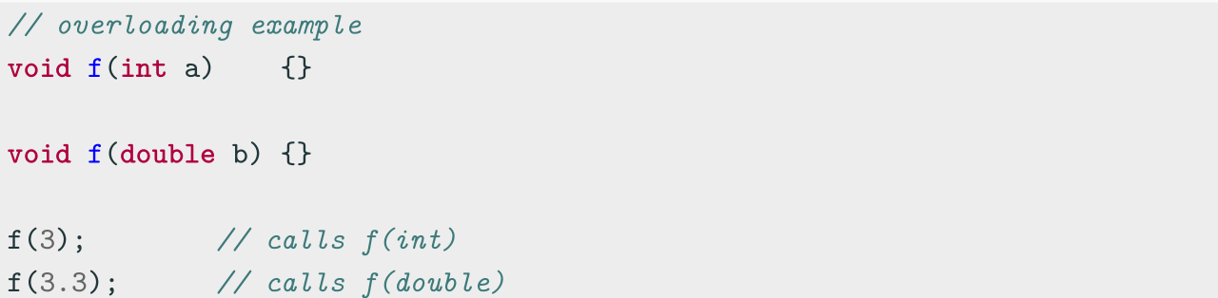
Polymorphism vs. Overloading
Overloading is a form of static polymorphism (compile-time polymorphism)
In C++, the term polymorphic is strongly associated with dynamic polymorphism
(overriding)

Slide 27
Function Binding
Connecting the function call to the function body is called Binding
• In Early Binding or Static Binding or Compile-time Binding, the compiler identifies
the type of object at compile-time
- the program can jump directly to the function address
• In Late Binding or Dynamic Binding or Run-time binding, the run-time identifies
the type of object at execution-time and then matches the function call with the
correct function definition
- the program has to read the address held in the pointer and then jump to that
address (less efficient since it involves an extra level of indirection)
C++ achieves late binding by declaring a virtual function

Slide 28
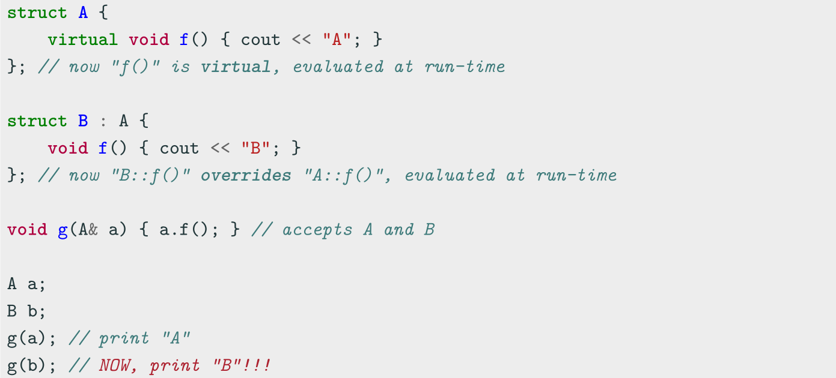
Polymorphism - virtual method
The virtual keyword is not necessary in derived classes, but it improves readability and
clearly advertises the fact to the user that the function is virtual

Slide 29
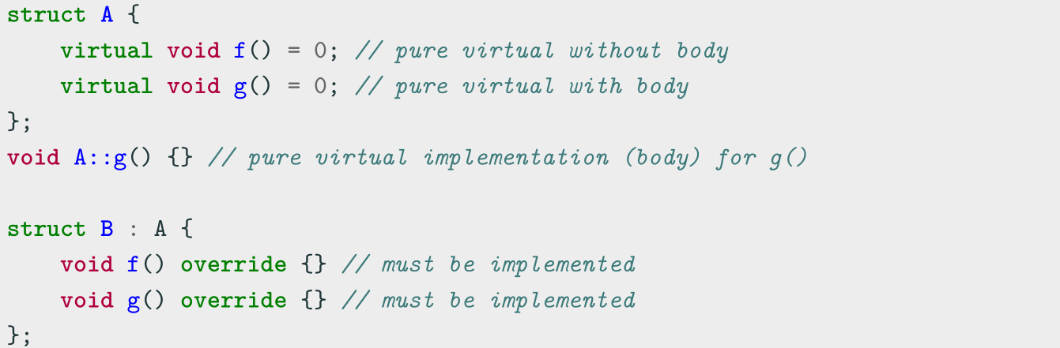
Pure Virtual Method
Pure Virtual Method
A pure virtual method is a function that must be implemented in derived classes (concrete implementation)
Pure virtual functions can have or not have a body

Slide 30
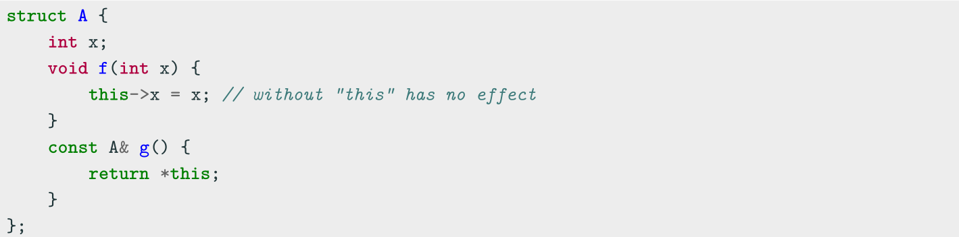
2.5 Class Keywords
this
Every object has access to its own address through the const pointer this
Explicit usage is not mandatory (and not suggested)
this is necessary when:
• The name of a local variable is equal to some member name
• Return reference to the calling object

Slide 31
Class Keywords——static
static
The keyword static declares members (fields or methods) that are not bound to class instances. A static member is shared by all objects of the class
• A static member function can only access static class members
• A non- static member function can access static class members
• Non-const static data members cannot be directly initialized inline ...before C++17

Slide 32
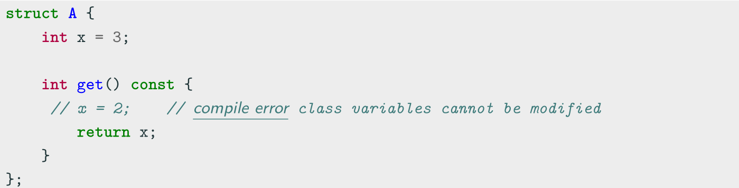
Class Keywords——const
Const member functions
Const member functions (inspectors or observer) are functions marked with const that are not allowed to change the object state
Member functions without a const suffix are called non-const member functions or mutators. The compiler prevents from inadvertently mutating/changing the data members of observer functions

Slide 33
Class Keywords——friend
friend Class
A friend class can access the private and protected members of the class in which it is declared as a friend
Friendship properties:
• Not Symmetric: if class A is a friend of class B, class B is not automatically a
friend of class A
• Not Transitive: if class A is a friend of class B, and class B is a friend of class C,
class A is not automatically a friend of class C
• Not Inherited: if class Base is a friend of class X, subclass Derived is not
automatically a friend of class X; and if class X is a friend of class Base, class X is
not automatically a friend of subclass Derived

Slide 34
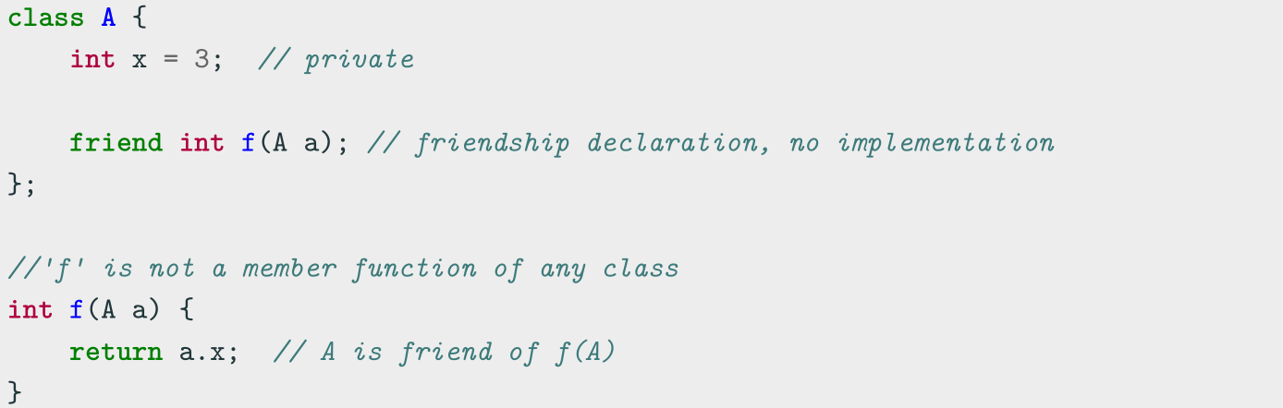
Class Keywords——friend
friend Method
A non-member function can access the private and protected members of a class if it is declared a friend of that class
friend methods are commonly used for implementing the stream operator operator<<

Slide 35
2.6 Templates
Template
A template is a mechanism for generic programming to provide a “schema” (or placeholders) to represent the structure of an entity
In C++, templates are a compile-time functionality to represent:
● A family of functions
● A family of classes
● A family of variables C++14

Slide 36
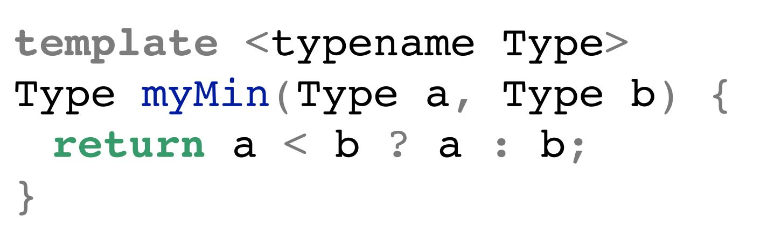
Function Template
Function Template
A function template is a function schema that operates with generic types (independent of any particular type) or concrete values
A function template works with multiple types without repeating the entire code for each of them:
Specifies that
Type is generic
List of your
template
variables
Indicating this
function is a template

Slide 37
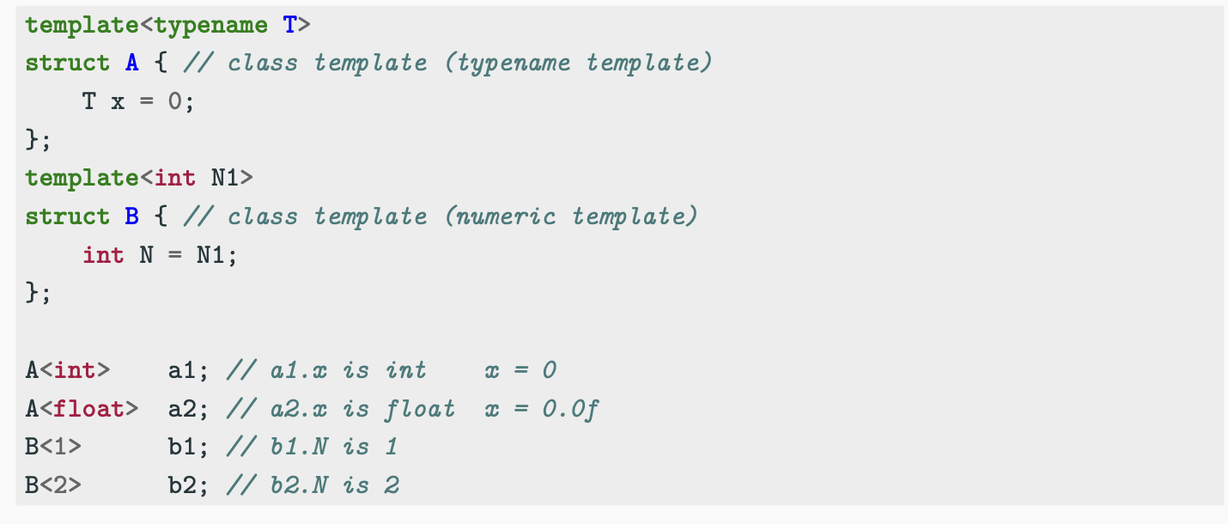
Class Template
Similarly to function templates, class templates are used to build a family of classes

Slide 38
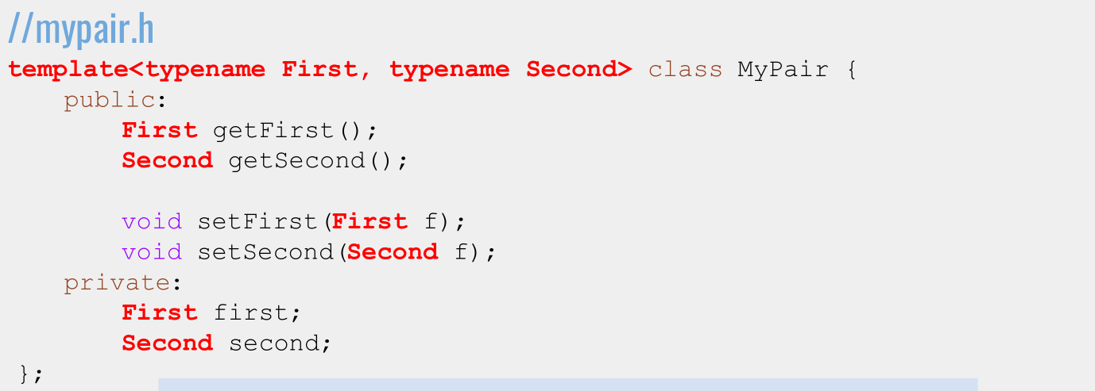

Template Class Example

Slide 39
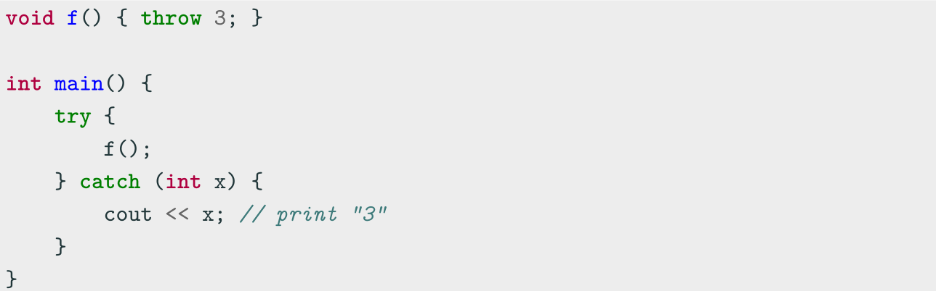
3. Advanced Topics
C++ Exception Basics
C++ provides three keywords for exception handling:
throw Throws an exception
try Code block containing potential throwing expressions
catch Code block for handling the exception

Slide 40
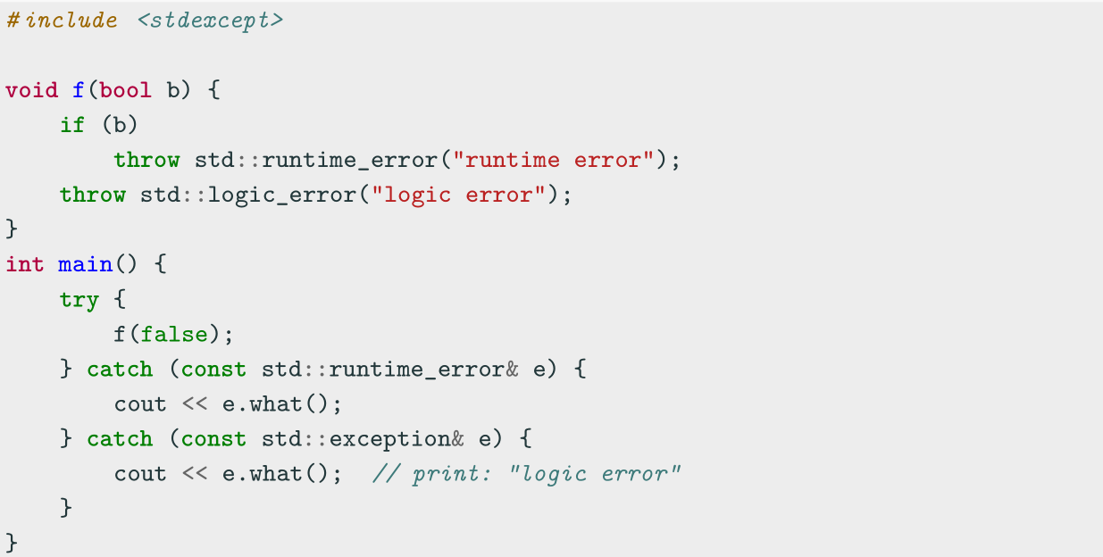
std Exceptions
throw can throw everything such as integers, pointers, objects, etc. The standard
way consists in using the std library exceptions <stdexcept>

Slide 41
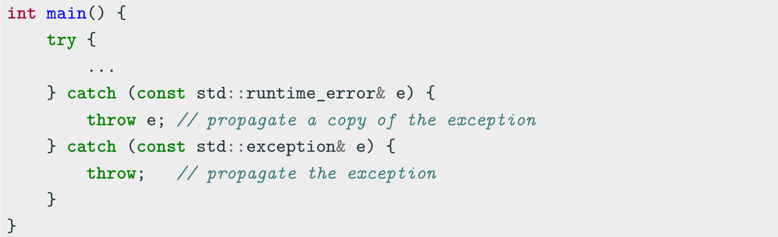
Exception Propagation
Exceptions are automatically propagated along the call stack. The user can also
control how they are propagated

Slide 42
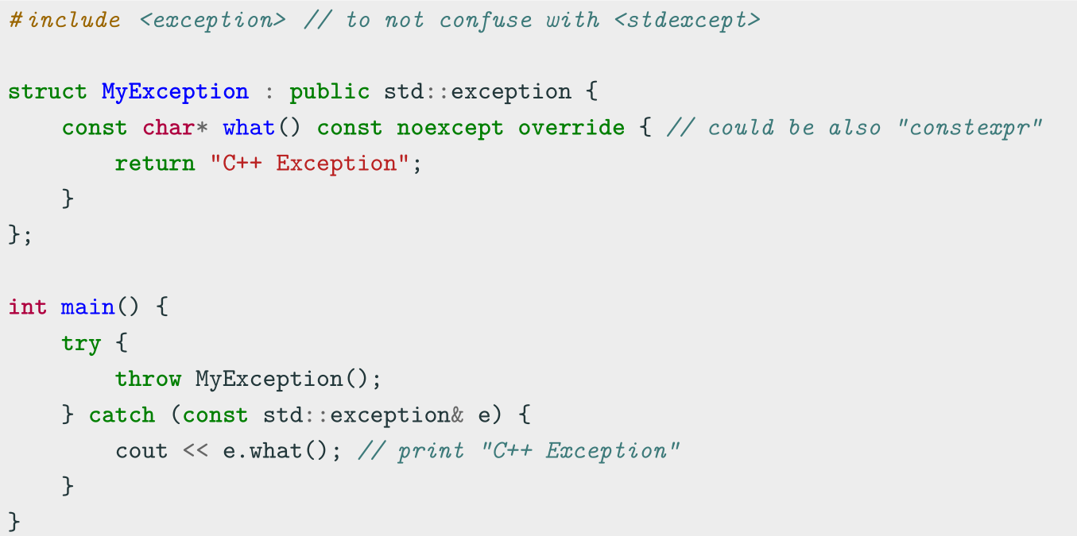
Defining Custom Exceptions

Slide 43
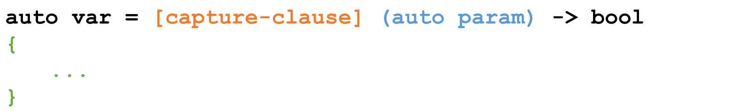
Lambdas Function
Lambdas are inline, anonymous functions that can know about functions declared in their same scope!
Outside parameters
go here
Specifies that
Type is generic
Function body
goes here!

Slide 44
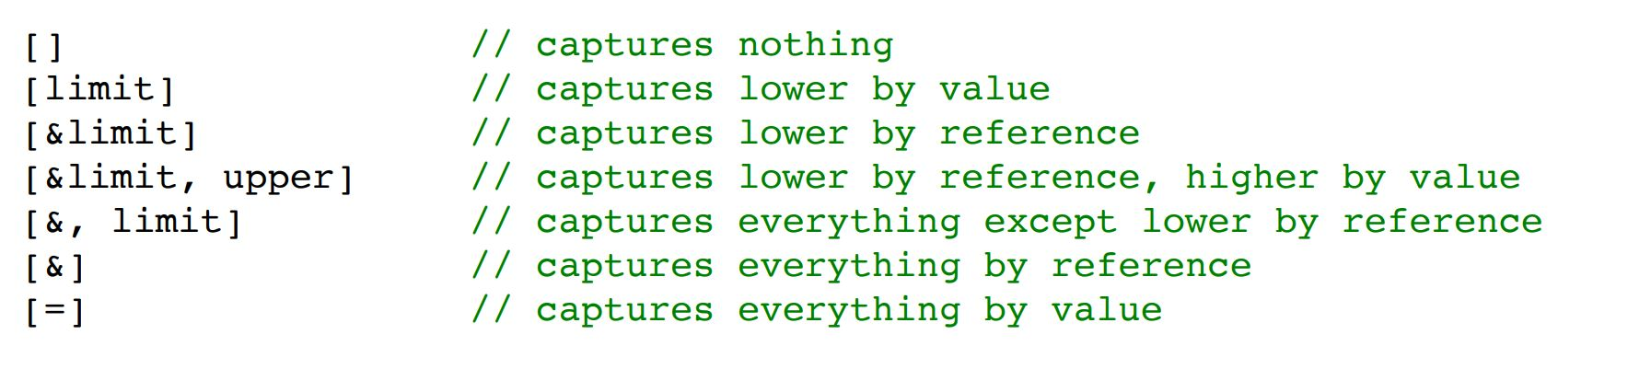
Capture Clauses
You can capture any outside variable, both by reference and by value.
● Use just the = symbol to capture everything by value,
and just the & symbol to capture everything by reference

Slide 45
Using Lambdas
Lambdas are pretty computationally cheap and a great tool!
● Use a lambda when you need a short function or to access local variables in your function.
● If you need more logic or overloading, use function pointers.

Slide 46
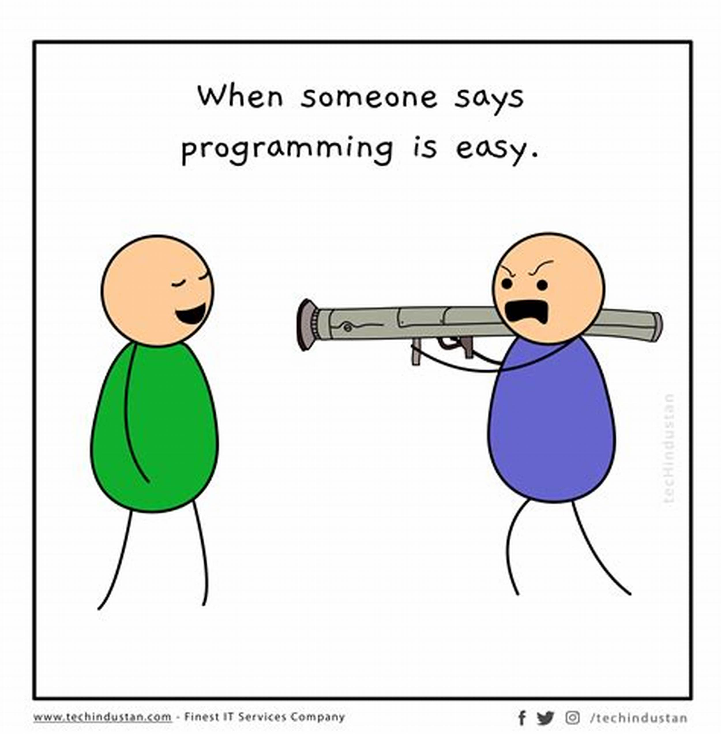
期末考试
时间：第17周星期三（6月19日）下午14:00—16:00
地点：江安综合楼B座B104
形式：闭卷（英文）
题型与分值：
单选题，30分
填空题，20分
概念解释题，20分
简答题，30分

Slide 47
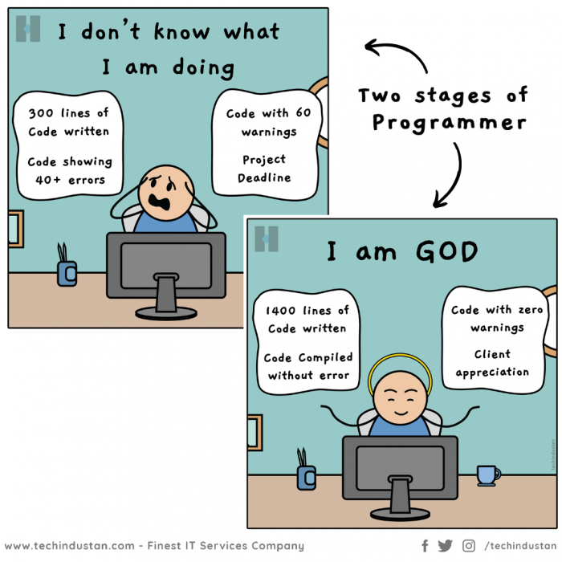
谢谢你们一学期的陪伴和共同进步，祝你们早日成为God Progammer!
https://syl.scu.edu.cn/info/1004/2708.htm
https://syl.scu.edu.cn/info/1004/2766.htm

Slide 48
Coding to make the world better
Qijun Zhao
qjzhao@scu.edu.cn

